Slide 1
Reviving Airbnb NYC Business in the Post-Covid Period
Audience – Head of Acquisition/Head of User Experience
Notes:
Objective

Slide 2
AGENDA
Objective
Background
Key findings
Recommendations
Appendix:
Data sources
Data methodology
Data model assumptions
Notes:
Objective

Slide 3
OBJECTIVE
Increase revenue of the company.
Improve our understanding of the customer preferences.
Provide recommendations to acquisition and user experience team.
Notes:
Objective

Slide 4
BACKGROUND
Hospitality market in US alone is estimated at $234 billion in 2024 and expected to reach $300 billion by 2029.
Global Smart Hospitality Market is estimated at $13.6 billion and projected to reach $50 billion by 2027.
Market is forecasted to grow at 29.8% for next 5 years.
Notes:
Objective

Slide 5
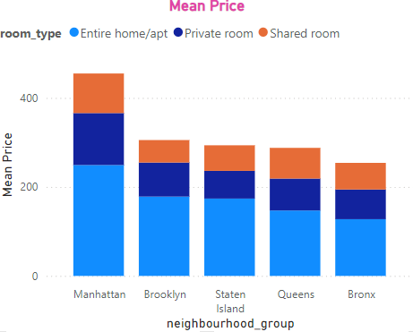
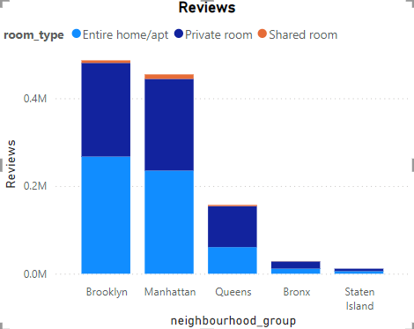
Type of Hosts and Areas to Target
Hosts with entire apartment listings have an average property listings of 10.7 which is much higher than hosts with other property types.
Entire apartment listings and private rooms are more popular throughout.
Brooklyn is the most popular area to rent out and Manhattan is the most expensive.
Notes:
Objective

Slide 6
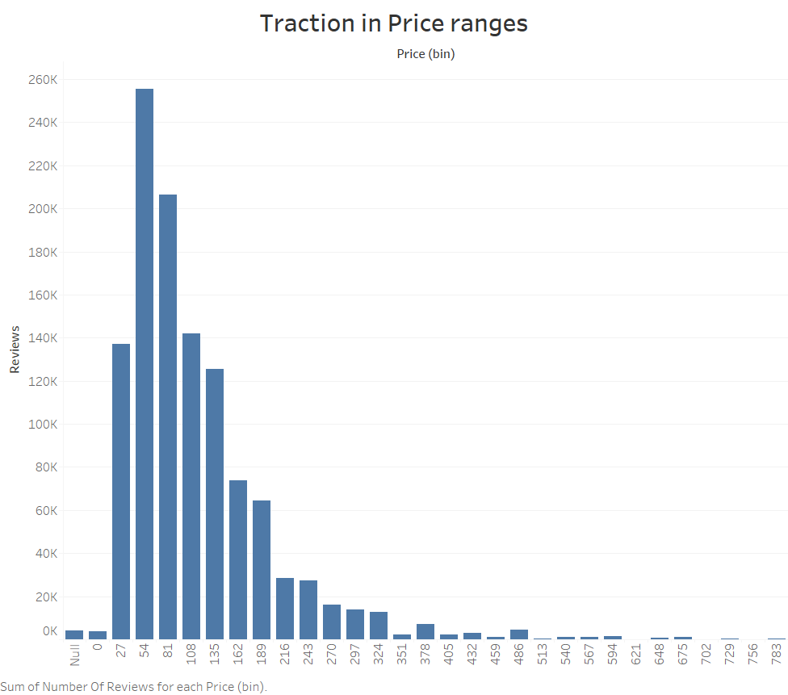
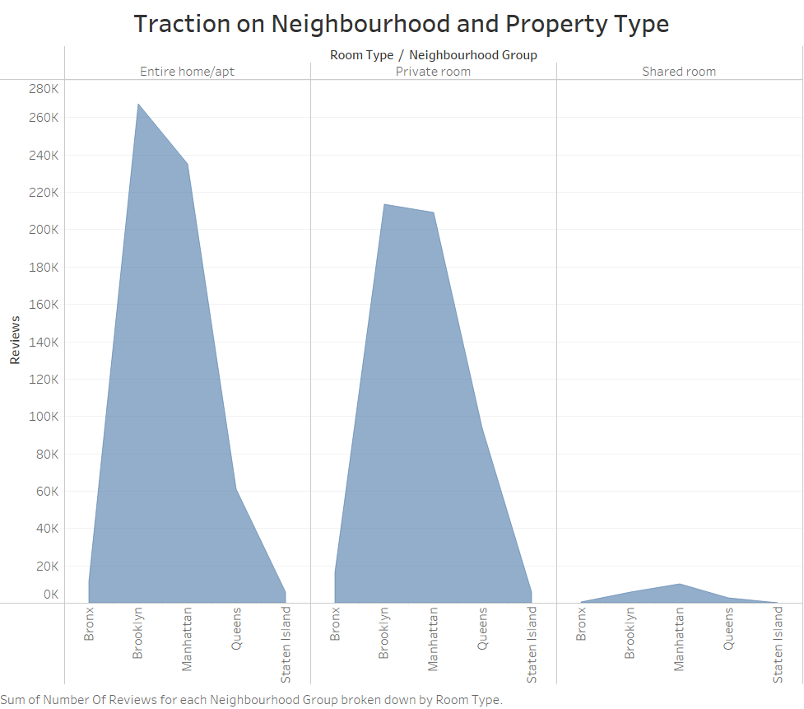
TOP CUSTOMER PREFERENCES
Traction is more for entire apartments and private rooms as compared to shared rooms.
Bedford-Stuyvesant in Brooklyn and Harlem in Manhattan are most popular areas in New York.
Customers are preferring properties between price range of $27-135 per night.
Notes:
Objective

Slide 7
KEY RECOMMENDATIONS TO IMPROVE PERFORMANCE OF EXISTING PROPERTIES
Hosts in Manhattan area with entire apartment listings have much higher listings on the platform than any other hosts. Acquiring more of these hosts will result in more property listings on platform.
More number of properties are rented when the minimum nights limit is between 0-3. Hence it is recommended to keep the minimum nights requirement as low as possible.
Reviews on platform were steadily increasing until 2018. But since last year to 2019 reviews have increased 7 times in one year. This depicts a sharp increase in demand in recent past that requires more acquisitions or increase capacity of existing properties to fulfill the increasing demand.

Slide 8
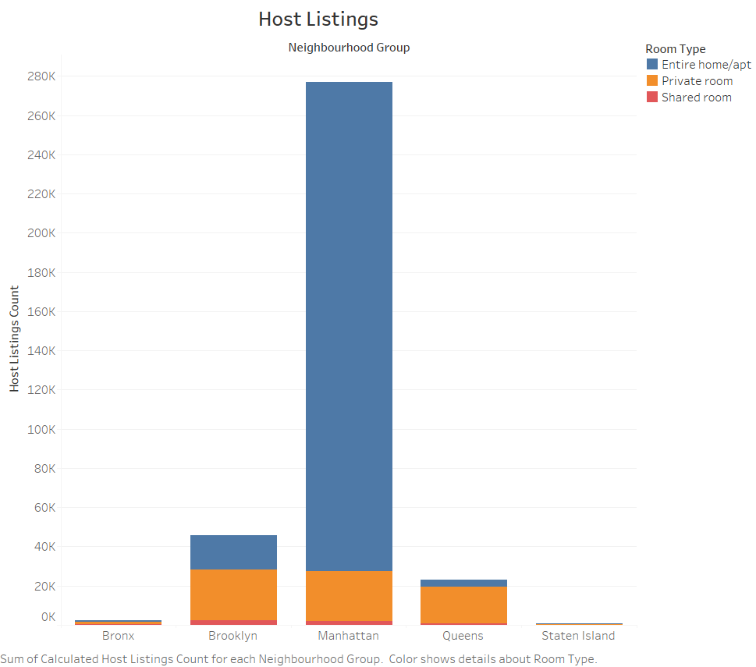
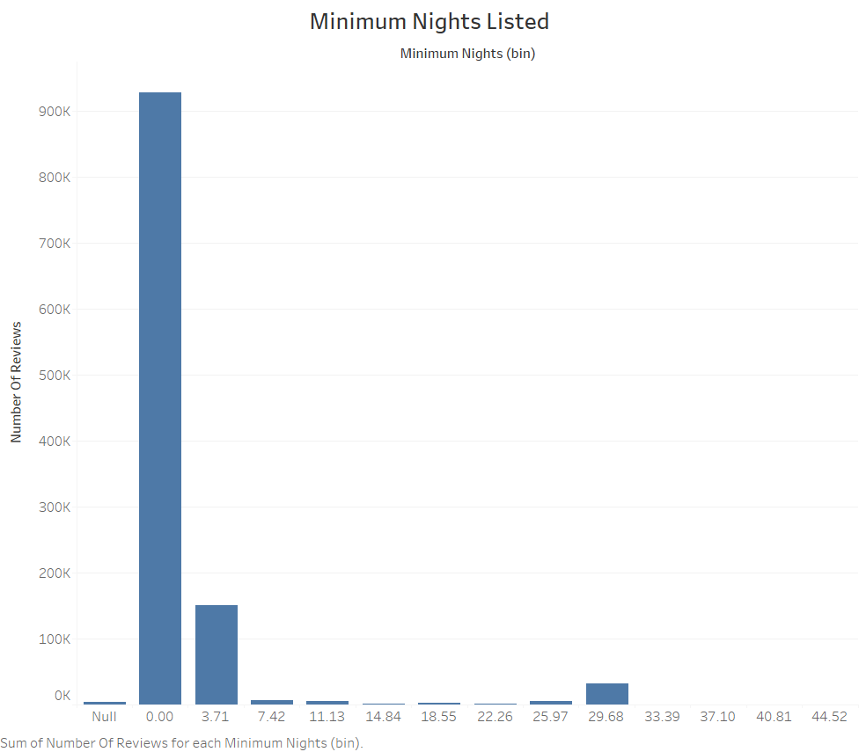
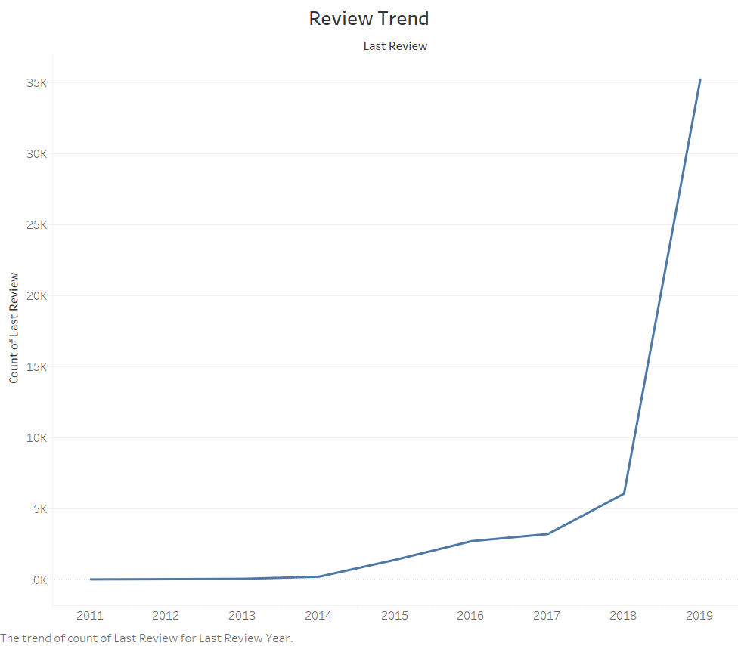
VISUALS TO SUPPORT KEY RECOMMENDATIONS TO IMPROVE PERFORMANCE OF EXISTING PROPERTIES

Slide 9
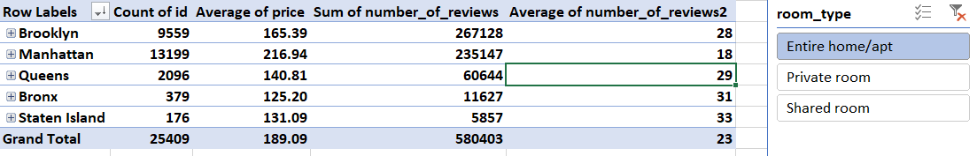
RECOMMENDATIONS TO IMPROVE TRACTION ON UNPOPULAR PROPERTIES AND LOCALITIES
Acquire more Shared Room properties to target small ticket size customers specially in Manhattan area.
Acquire more of these Shared room properties, improve customer experience increase quality and availability, increase price would mean better customer experience and perception of low cost properties.
Acquisition of shared rooms and private rooms should be ramped up in the Staten Island area as the average review per property is highest in Staten Island and average price of shared room is second highest after Manhattan.
Notes:
Objective

Slide 10
RECOMMENDATIONS TO IMPROVE USER EXPERIENCE
List Entire home or apartment properties on top, Private room properties second in Manhattan area.
List the Private rooms on top, Entire apartment properties second in Brooklyn area.
List properties in Bedford-Stuyvesant locality on top in Brooklyn area and properties in Harlem locality on top in Manhattan area.
Notes:
Objective

Slide 11
APPENDIX - DATA SOURCES:
Here is a snapshot of our data dictionary.
Metadata on host and property types such as location, area, locality, type of property.
Fact information like price, reviews per month, availability, number of listings.
The team used the following data sources:
Airbnb New York Data.
Notes:
Objective

Slide 12
APPENDIX - DATA METHODOLOGY & DATA ASSUMPTIONS
Please refer to the attached Methodology Document
Notes:
Objective

